Slide 1
Sallie Holder Blue Glass Collection
Printed transcript from
UPWC Zoom Meeting: 1/3/2022

Slide 2
Background for Presentation
The following glass collection is presented by Sallie Holder. Sallie has been a University Park resident where her parents owned a house for 50 years before she came back and lived there for 13 years. In 2019, she moved to Riderwood Retirement Center.
The following slides are from Sallie’s collection of Cobalt Glass (with the exception of some Blenko glass pieces), a hobby for many years.

Slide 3
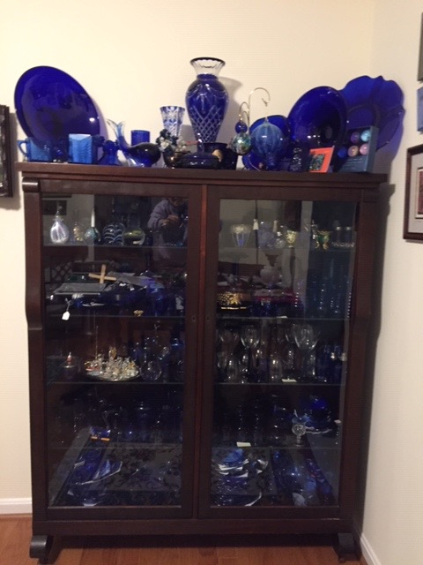
Picture 1: Cobalt Blue Glass Collection
The collection is housed in an old bookcase from Sallie’s paternal Grandparent’s house. They are the remaining pieces after selling 450 pieces from the glass collection before moving to Riderwood.
The cobalt blue glass collection started in 1988, some 30 years ago, It started by seeing a cobalt blue glass Baltimore shoe polish bottle sitting in the sun on a makeshift flea market table outside an antique shop on the Eastern shore. This was the first step in a search for cobalt blue glass bottles and Depression glass (continued on next slide)

Slide 4
(continued)
The blue Depression glass matched the glass found in Sallie’s Grandmother’s china closets. While there was not a lot to eat during the Depression, multi-colored Depression glass brightened up the family’s dining table.
Although Sallie’s glass collection began as a hobby, she soon joined the DELMARVA Depression Glass Club which met once a month at Bell’s Methodist Church in Camp Springs, Maryland. Prior to Covid, Club meetings were moved to the Greenbelt Lutheran Church in Greenbelt, Maryland.

Slide 5
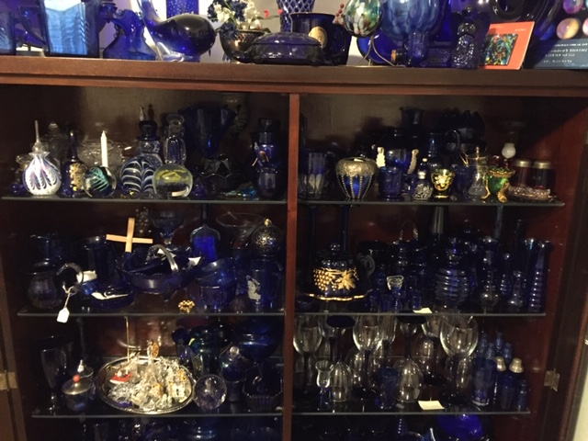
Picture 2: Continuation of Blue Glass Collection
The first two shelves of glass pieces are from my Grandmother Austin’s china closet: vases of various sizes, a Collyrium eye cup, a Shirley Temple mug, tall candle sticks and a reproduction of an
(continued on next slide)

Slide 6
(continued)
Old butter dish trimmed with gold.
The third shelf is mostly 90’s Fostoria table glassware, with cobalt blue stems and clear bowl to go with my place settings of cobalt blue Royal Lace and a tray of Swarovski mini collectibles from Sallie’s mom, stepmom and her own collection.

Slide 7
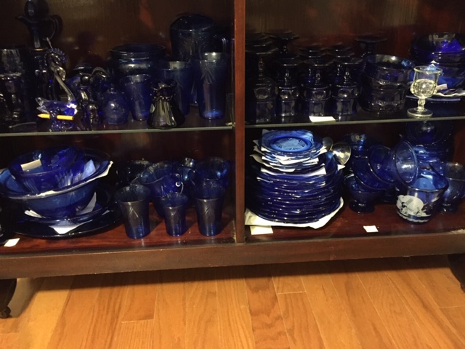
Picture 3: A look at the 4th and 5th shelves of the bookcase
The fourth shelf is basically cobalt blue King’s Crown goblets, juice glasses, and dessert dishes to go with the main pattern of cobalt blue Royal Lace. King’s Crown was made by a lot of different glass companies, these may have been made by Indiana Glass.
The 5th shelf shows eight place settings of Royal Lace and its
(continued on next slide)

Slide 8
(continued)
serving pieces made by Hazel Atlas Glass Co. It was a box office hit when it was produced in 1934 through 1941. It was made in different colors and in crystal clear version which was sold in Sears and Roebuck in groups of four place settings for $4.99. Each piece now is worth significantly more. Hazel Atlas also made the Shirley Temple piece mentioned earlier. When the Shirley Temple contract was cancelled, the leftover blue glass was used to make Royal Lace.

Slide 9
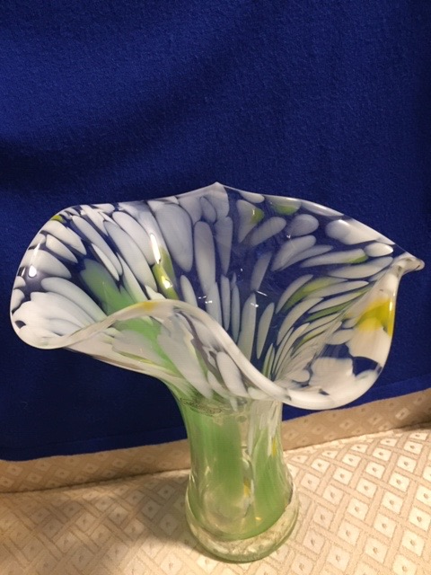
Picture 4: Blenko Glass
The vase pictured on the left is an example of the 2017 Blenko glass daffodil vase which Sallie purchased on Mother’s day, May 2017 in the Blenko factory store, when NAGC has their annual glass convention in Charleston, WVA.

Slide 10
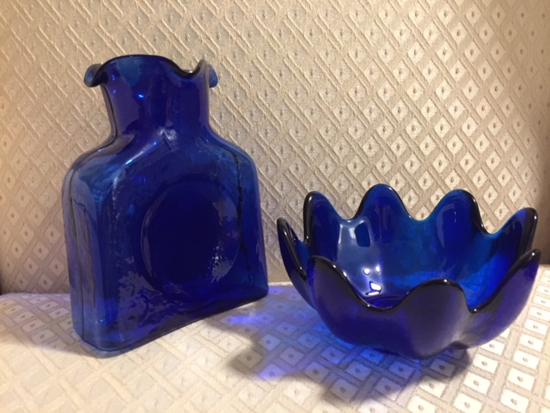
Picture 5: Cobalt blue Blenko Glass
On the left is a water bottle, a standard piece made in various shapes since 1938 when Blenko started manufacturing glass for the “new electric refrigerator.”
The right piece is a typical bowl shape used by Blenko as a gift on WETA TV fundraisers.

Slide 11
At this point, there would have been a presentation from Francis Allen, past president of the National American Glass Club, of which Sallie is a member.
Mr. Allen is a collector and researcher on all kinds of glass. Blenko glass was to be the focus of his presentation. However, due to technical difficulties after the zoom meeting, his Powerpoint presentation was unretrievable. Participants of the zoom meeting are who are interested in seeing more of the handcrafted artisan glass are encouraged to visit the Blenko Glass Co., 9 Bill Blenko Drive, Milton, WVA 25541. (304) 743-9081. If you would like to arrange a tour or visit their glass museum, arrangements can be made by accessing the website: www.blenko.com

